Slide 1
Tutorial 3

Slide 2
Outline
Comparison-Based
  Selection Sort
  Bubble Sort (Tutorial 2)
  Cocktail Sort
  Insertion Sort
  Merge Sort
  Tim Sort(*)

Slide 3
Selection Sort
Selection sort is a sorting algorithm that selects the smallest element from an unsorted list in each iteration and places that element at the beginning of the unsorted list.

Slide 4
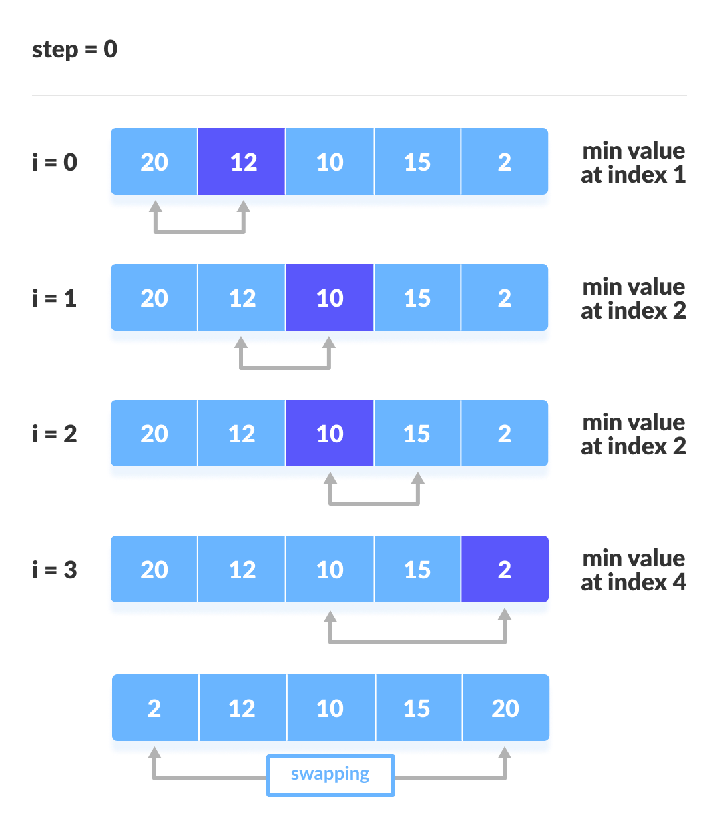
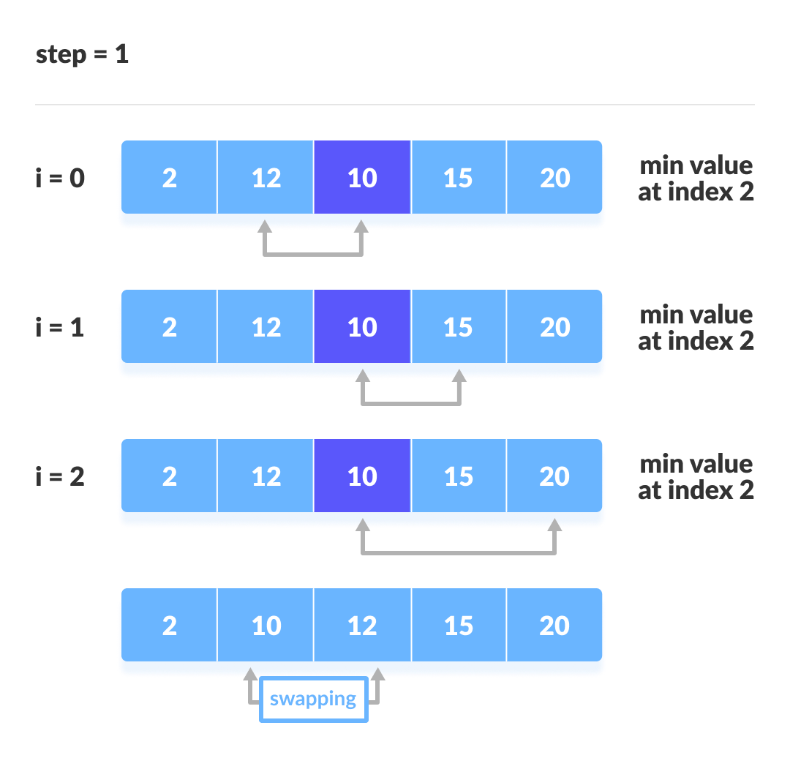
A toy example (From Programiz)

Slide 5
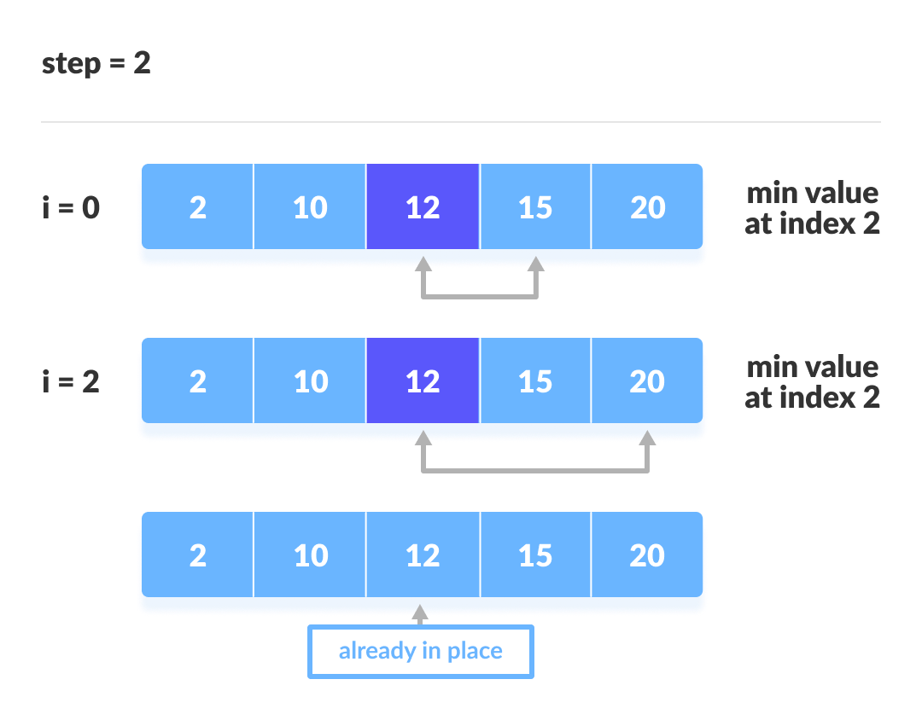
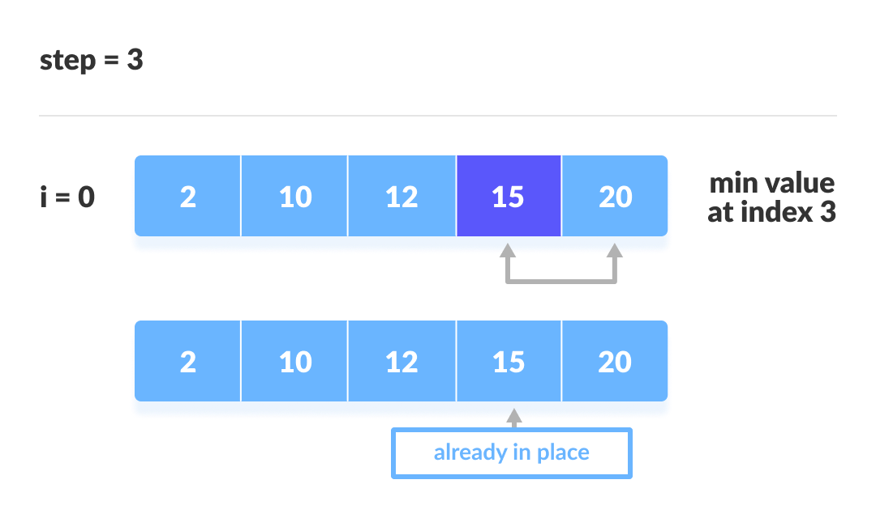

Slide 6
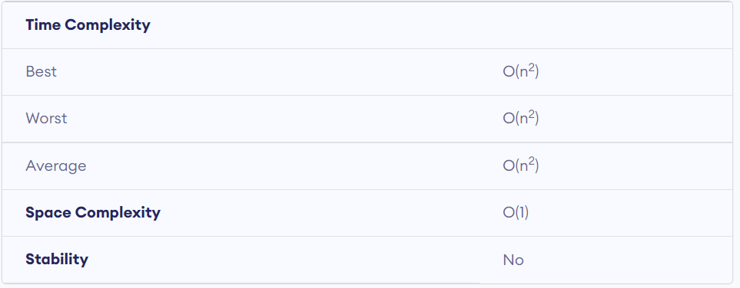
Selection Sort

Slide 7
Cocktail Sort
Cocktail Sort is a variation of Bubble sort. The Bubble sort algorithm always traverses elements from left and moves the largest element to its correct position in the first iteration and second-largest in the second iteration and so on. Cocktail Sort traverses through a given array in both directions alternatively. Cocktail sort does not go through the unnecessary iteration making it efficient for large arrays.

Slide 8
A toy example (From GeeksforGeeks)
First Forward Pass:
(5 1 4 2 8 0 2) ? (1 5 4 2 8 0 2), Swap since 5 > 1
(1 5 4 2 8 0 2) ? (1 4 5 2 8 0 2), Swap since 5 > 4
(1 4 5 2 8 0 2) ? (1 4 2 5 8 0 2), Swap since 5 > 2
(1 4 2 5 8 0 2) ? (1 4 2 5 8 0 2)
(1 4 2 5 8 0 2) ? (1 4 2 5 0 8 2), Swap since 8 > 0
(1 4 2 5 0 8 2) ? (1 4 2 5 0 2 8), Swap since 8 > 2

Slide 9
First Backward Pass:
(1 4 2 5 0 2 8) ? (1 4 2 5 0 2 8)
(1 4 2 5 0 2 8) ? (1 4 2 0 5 2 8), Swap since 5 > 0
(1 4 2 0 5 2 8) ? (1 4 0 2 5 2 8), Swap since 2 > 0
(1 4 0 2 5 2 8) ? (1 0 4 2 5 2 8), Swap since 4 > 0
(1 0 4 2 5 2 8) ? (0 1 4 2 5 2 8), Swap since 1 > 0
Second Forward Pass:
(0 1 4 2 5 2 8) ? (0 1 4 2 5 2 8)
(0 1 4 2 5 2 8) ? (0 1 2 4 5 2 8), Swap since 4 > 2
(0 1 2 4 5 2 8) ? (0 1 2 4 5 2 8)
(0 1 2 4 5 2 8) ? (0 1 2 4 2 5 8), Swap since 5 > 2
Second Backward Pass:
(0 1 2 4 2 5 8) ? (0 1 2 2 4 5 8), Swap since 4 > 2

Slide 10
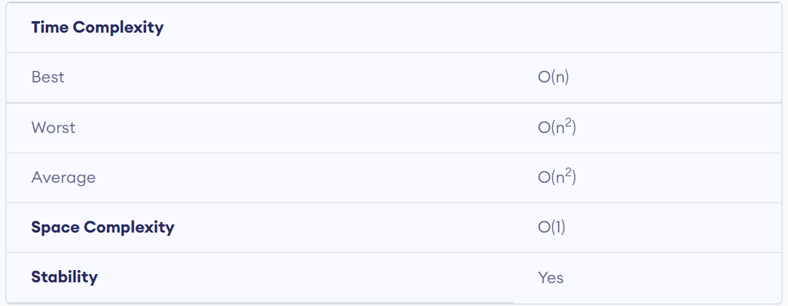
Cocktail Sort

Slide 11
Insertion Sort
Insertion sort is a simple sorting algorithm that works similar to the way you sort playing cards in your hands.

Slide 12
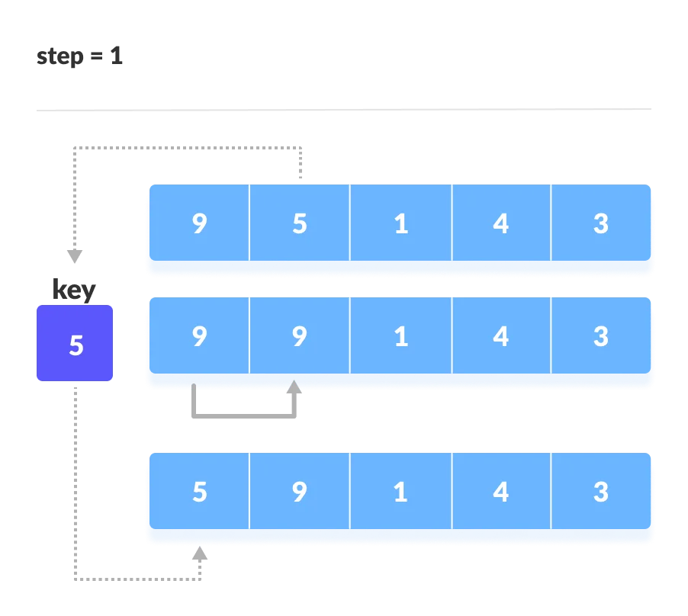
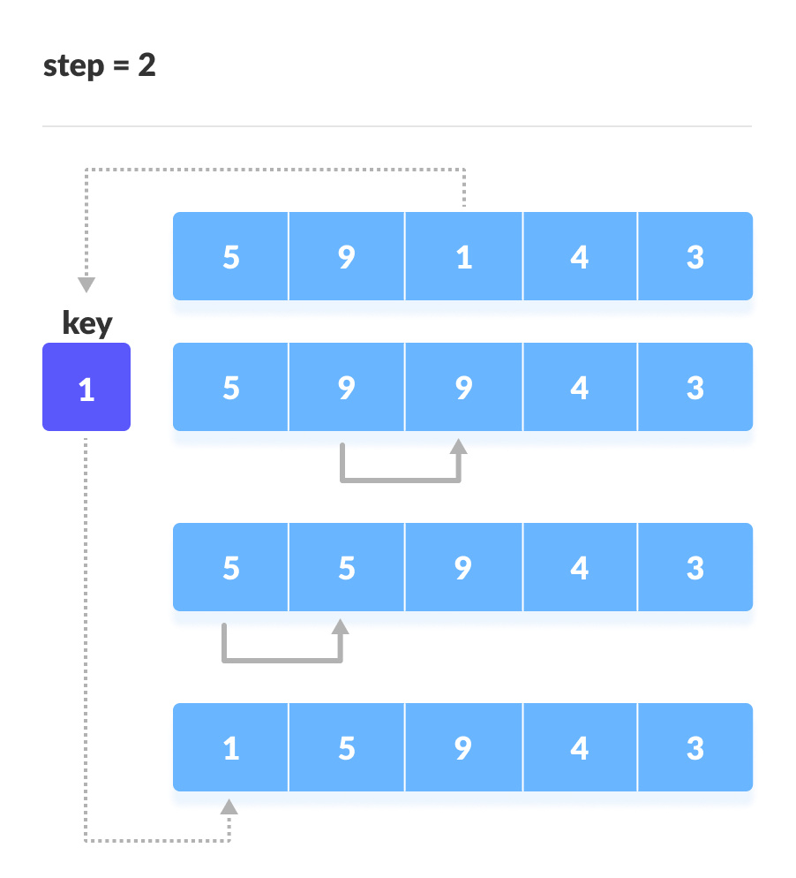
A toy example (From Programiz)

Slide 13
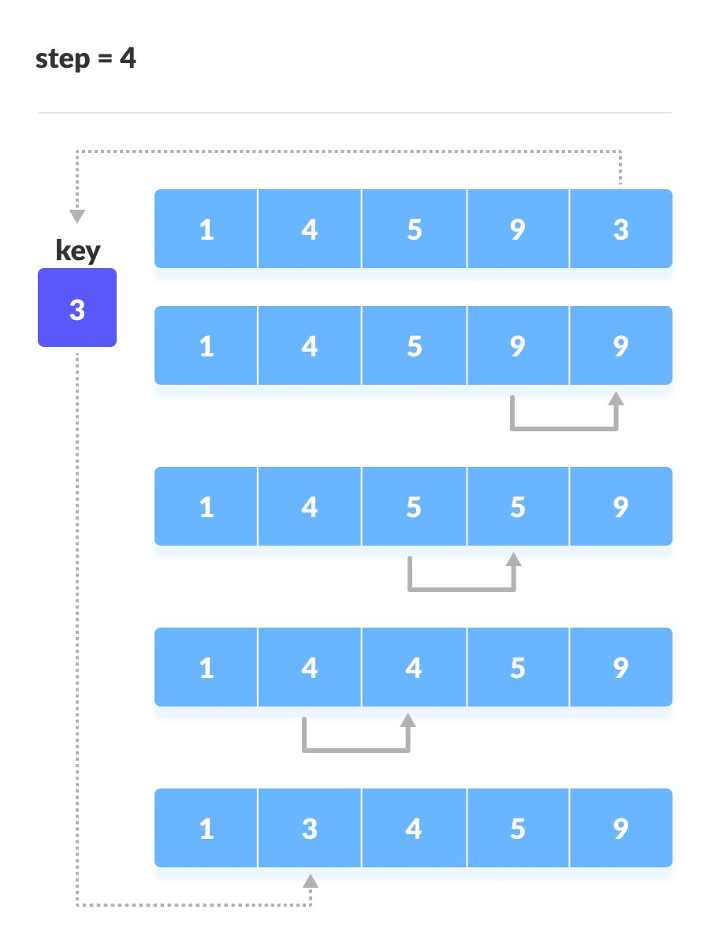


Slide 14
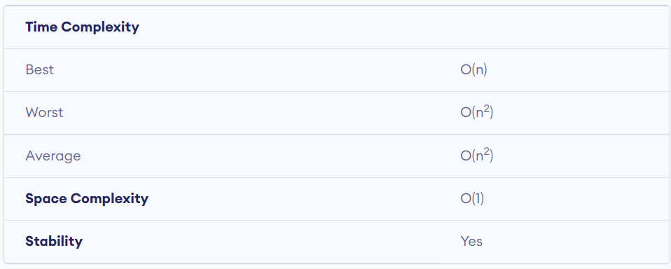
Insertion Sort

Slide 15
Merge Sort
The Merge Sort function repeatedly divides the array into two halves until we reach a stage where we try to perform Merge Sort on a subarray of size 1 i.e. p == r.
After that, the merge function comes into play and combines the sorted arrays into larger arrays until the whole array is merged.

Slide 16
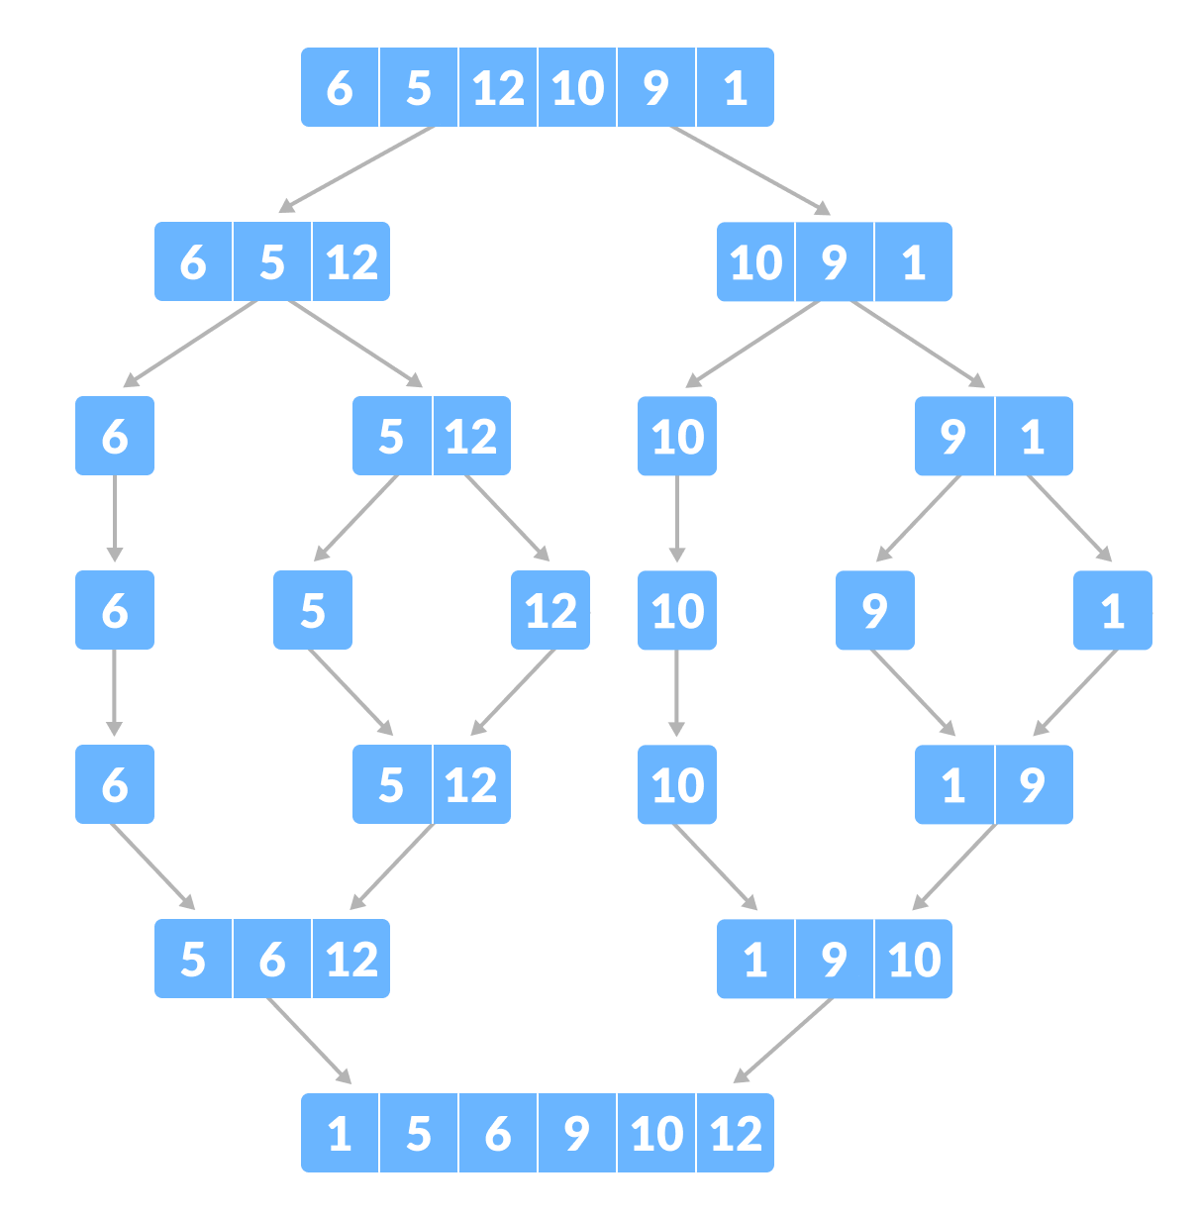
A toy example (From Programiz)

Slide 17
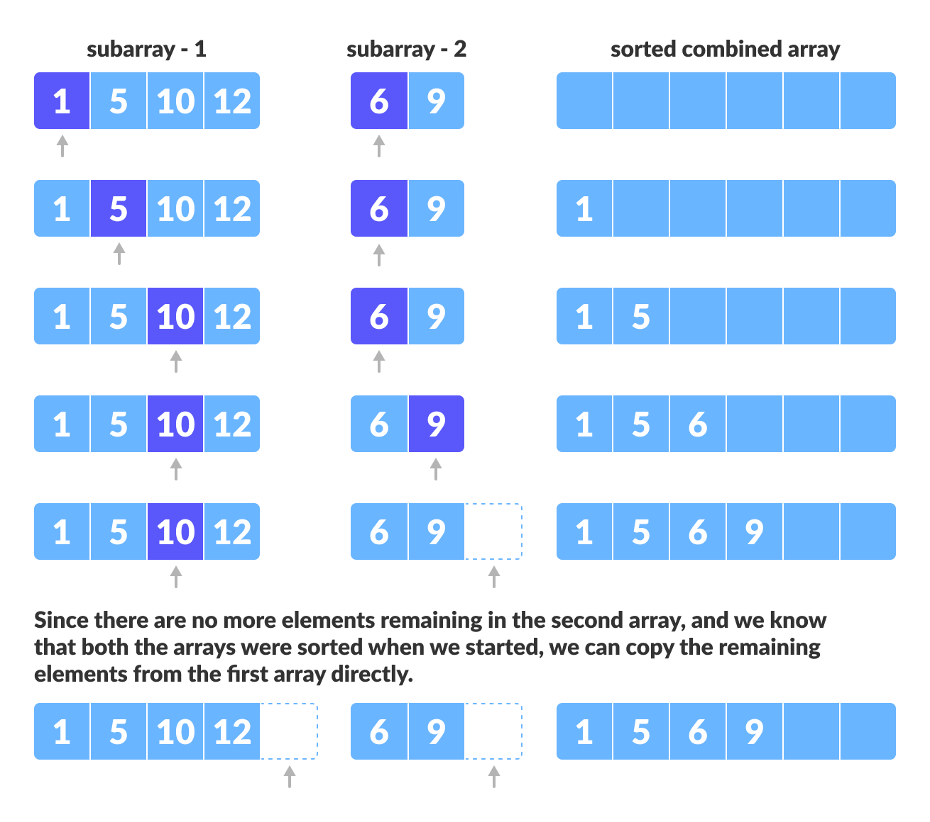

Slide 18
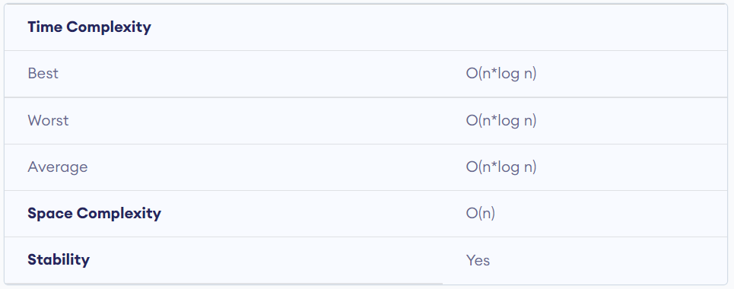
Merge Sort

Slide 19
Tim Sort(*)
TimSort is a sorting algorithm based on Insertion Sort and Merge Sort.
Used in Java’s Arrays.sort() as well as Python’s sorted() and sort().
First sort small pieces using Insertion Sort, then merges the pieces using a merge of merge sort.

Slide 20
We divide the Array into blocks known as Run.
We sort those runs using insertion sort one by one and then merge those runs using the combine function used in merge sort. If the size of the Array is less than run, then Array gets sorted just by using Insertion Sort.
The size of the run may vary from 32 to 64 depending upon the size of the array. Note that the merge function performs well when size subarrays are powers of 2. The idea is based on the fact that insertion sort performs well for small arrays.

Slide 21
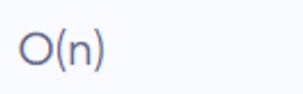
Tim Sort

